Slide 1
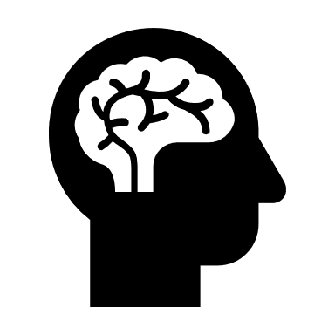
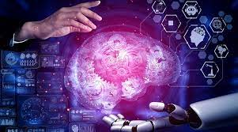
MACHINE LEARNING AND DEEP LEARNING
SUBMITTED BY
K.PAVANSAI

Slide 2
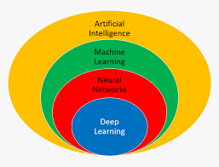

Slide 3
CONTENTS
INTRODUCTION
MACHINE LEARNING
DEEP LEARNING
DIFFERENCE BETWEEN MACHINE LEARNING AND DEEP LEARNING
CONCLUSION

Slide 4
INTRODUCTION
A brief history of AI: "People have been working on AI since the 1950s, but progress has been slow until recently."
what Machine Learning : "Machine learning is a type of AI that lets computers learn from data and make decisions based on that learning."
Importance of Machine Learning: "Machine learning is used in many areas to automate tasks and discover patterns in data, which can help improve efficiency and accuracy."
what Deep Learning : "Deep learning is a type of machine learning that uses special algorithms called neural networks to learn complex patterns in data."
Importance of Deep Learning: "Deep learning has helped achieve impressive results in many fields, like speech recognition, image recognition, and self-driving cars."

Slide 5
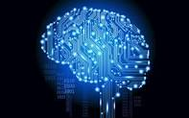
MACHINE LEARNIG
Definition of Machine Learning: "Machine learning is a subfield of AI that focuses on developing algorithms that can learn from data and make predictions or decisions based on that learning, without being explicitly programmed.“

Slide 6
TYPES OF MACHINE LEARNING
Supervised Learning: Learn from labeled examples to make predictions.
Unsupervised Learning: Find patterns in unlabeled data.
Reinforcement Learning: Learn by trial and error through interactions with an environment.

Slide 7
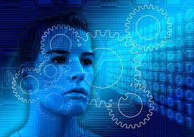
APPLICATIONS AND EXAMPLES OF MACHINE LEARINING
Image and Video Recognition:
Image and video recognition is the process of using machine learning algorithms to identify and classify objects, people, or other features within images or videos.
Examples: facial recognition, object detection, and image classification.
Applications: security systems, self-driving cars, and healthcare diagnostics.

Slide 8
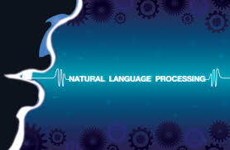
APPLICATIONS AND EXAMPLES OF MACHINE LEARINING
Natural Language Processing:
Natural Language Processing (NLP) is a branch of machine learning that focuses on the interaction between computers and human language, with the goal of enabling computers to understand, interpret, and generate human language.
Examples: sentiment analysis, speech recognition, and language translation.
Applications: chatbots, virtual assistants, and search engines.

Slide 9

APPLICATIONS AND EXAMPLES OF MACHINE LEARINING
Fraud Detection:
Fraud detection is the process of using machine learning algorithms to identify and prevent fraudulent activities or transactions.
Examples: credit card fraud detection, anti-money laundering, and identity theft prevention.
Applications: banking and finance, healthcare insurance, and e-commerce.

Slide 10
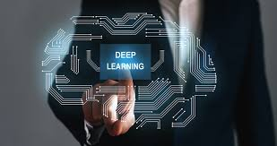
DEFINITION OF DEEP LEARNING
Deep learning is a subset of machine learning that involves building artificial neural networks with multiple layers that can learn to recognize and classify complex patterns in data. These neural networks are inspired by the structure and function of the human brain, and can be trained on large amounts of data to improve their accuracy and predictive capabilities. Deep learning has shown remarkable success in a wide range of applications, including image and speech recognition, natural language processing, and self-driving cars.

Slide 11
Neural Networks and their components
Neural Networks are a subset of machine learning algorithms that are modeled after the structure and function of the human brain. The components of a neural network include layers, neurons, and activations.
Layers are the building blocks of a neural network and are composed of a set of neurons. Neurons are individual processing units that receive inputs and produce outputs. Activations are functions that are applied to the output of each neuron to introduce non-linearity into the network.

Slide 12
Types of Neural Networks
Feedforward Neural Networks: These are the simplest type of neural network and consist of an input layer, one or more hidden layers, and an output layer.
Convolutional Neural Networks: These are commonly used in image and video recognition tasks and have convolutional layers that can identify spatial patterns in the input data.
Recurrent Neural Networks: These are useful for processing sequences of data and have recurrent connections between neurons that allow them to remember previous inputs.

Slide 13
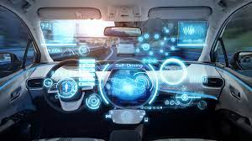
APPLICATIONS OF DEEP LEARNING
Image Recognition: Deep learning models can be trained to identify objects in images, such as people, animals, and buildings.
Natural Language Processing: Deep learning models can be used to analyze and understand natural language, including speech recognition and language translation.
Self-Driving Cars: Deep learning is being used to develop self-driving cars, which use a combination of computer vision and machine learning techniques to navigate roads and avoid obstacles.

Slide 14
EXAMPLES OF DEEP LEARNING FRAMEWORKS AND LIBRARIES TRAINING AND EVALUATION
TensorFlow: Developed by Google, TensorFlow is a popular deep learning framework used for building and training neural networks.
PyTorch: Developed by Facebook, PyTorch is a deep learning library that is known for its ease of use and flexibility.
Keras: Keras is a high-level neural network library that provides a simple and intuitive interface for building and training deep learning models.

Slide 15
DIFFERENCES BETWEEN MACHINE LEARNING AND DEEP LEARNING:
Machine learning and deep learning are both subfields of artificial intelligence (AI) that are used to teach computers to perform tasks without being explicitly programmed. The main difference between the two is the complexity of the algorithms used.
Machine learning uses simpler algorithms to process and learn from data, whereas deep learning uses more complex neural networks that are inspired by the structure of the human brain.

Slide 16
WHEN TO USE MACHINE LEARNING VS. DEEP LEARNING:
The choice between machine learning and deep learning depends on the specific task and the complexity of the data. Machine learning is well-suited for simpler tasks such as image classification or spam filtering, while deep learning is better for more complex tasks such as natural language processing or object recognition.

Slide 17
CONCLUSION:
In conclusion, both machine learning and deep learning are powerful tools for developing intelligent systems. The choice between the two depends on the specific task and the complexity of the data.

Slide 18
RECAP OF MAIN POINTS:
Machine learning uses simpler algorithms, while deep learning uses more complex neural networks.
Machine learning is better for simpler tasks, while deep learning is better for more complex tasks.
The choice between machine learning and deep learning depends on the specific task and the complexity of the data.

Slide 19
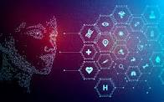
FUTURE OF MACHINE LEARNING AND DEEP LEARNING:
The future of machine learning and deep learning is bright, with continued advancements in hardware and software driving progress in these fields. As more data becomes available, and more powerful algorithms are developed, the potential applications for these technologies are virtually limitless.

Slide 20
THANK YOU

